Slide 1
An Introduction to
Pattern Recognition
Speaker : Wei–lun Chao
Advisor : Prof. Jian-jiun Ding
DISP Lab
Graduate Institute of Communication Engineering
National Taiwan University, Taipei, Taiwan
National Taiwan University, Taipei, Taiwan
DISP Lab @ MD531

Slide 2
Abstract
Not a new research field
Wide range included
Enhancement by some factors:
Computer architecture
Machine learning
Computer vision
New way of thinking
Improving human’s life
National Taiwan University, Taipei, Taiwan
DISP Lab @ MD531

Slide 3
Outline – What’s included
What is pattern recognition
Basic structure
Different techniques
Performance Care
Example of applications
Related works
National Taiwan University, Taipei, Taiwan
DISP Lab @ MD531

Slide 4
Content
1. Introduction
2. Basic Structure
3. Classification method I
4. Classification method II
5. Classification method III
6. Feature Generation
7. Feature Selection
8. Outstanding Application
9. Relation between IT and D&E
10. Conclusion
National Taiwan University, Taipei, Taiwan
DISP Lab @ MD531

Slide 5
1. Introduction
Pattern recognition is a process that taking in raw data and making an action based on the category of the pattern.
What does a pattern means?
“A pattern is essentially an arrangement”, N. Wiener [1]
“A pattern is the opposite of a chaos”, Watanabe
To be simplified, the interesting part
National Taiwan University, Taipei, Taiwan
DISP Lab @ MD531

Slide 6
What can we do after analysis?
Classification (Supervised learning)
Clustering (Unsupervised learning)
Other applications
Category “A”
Category “B”
Classification
Clustering
National Taiwan University, Taipei, Taiwan
DISP Lab @ MD531

Slide 7
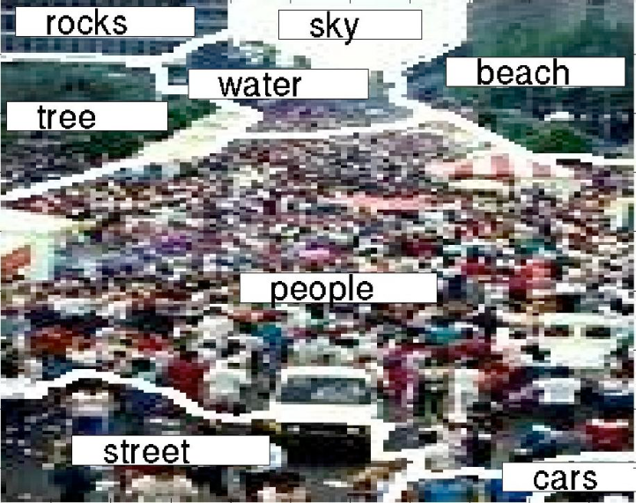
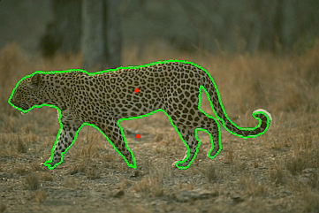
Why we need pattern recognition?
Human beings can easily recognize things or objects based on past learning experiences! Then how about computers?
National Taiwan University, Taipei, Taiwan
DISP Lab @ MD531

Slide 8
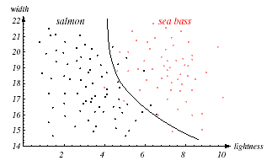
2. Basic Structure
Two basic factors: Feature & Classifier
Feature: Car → Boundary
Classifier: Mechanisms and methods to define what the pattern is
National Taiwan University, Taipei, Taiwan
DISP Lab @ MD531

Slide 9
System structure
The feature should be well-chosen to describe the pattern!!
Knowledge: experience, analysis, trial & error
The classifier should contain the knowledge of each pattern category and also the criterion or metric to discriminate among patterns classes.
Knowledge : direct defined or “training“
National Taiwan University, Taipei, Taiwan
DISP Lab @ MD531

Slide 10
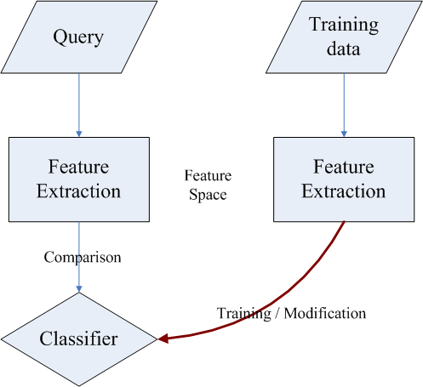
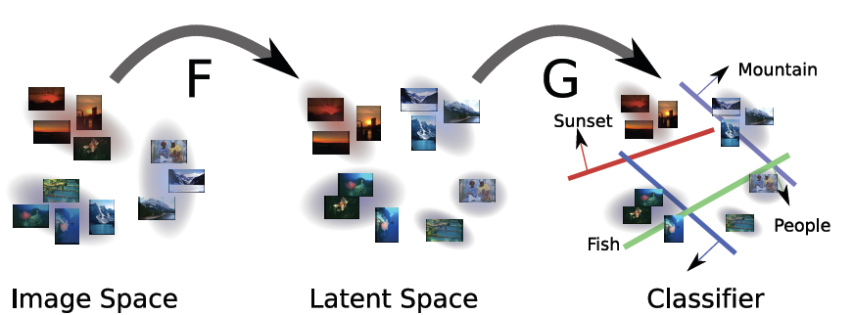
Figure of system structure
National Taiwan University, Taipei, Taiwan
DISP Lab @ MD531

Slide 11
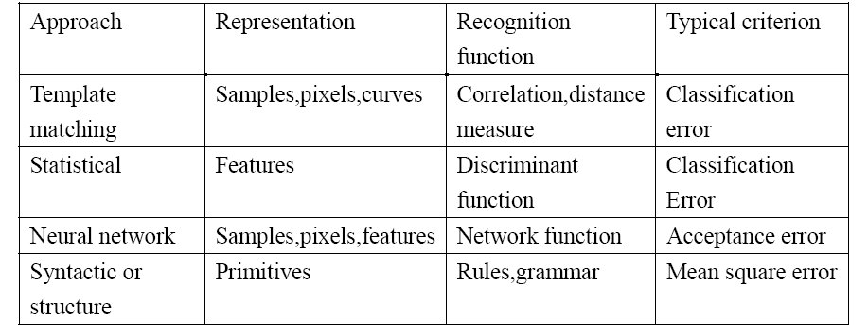
Four basic recognition models
Template matching
Syntactic
Statistical
Neural Network
National Taiwan University, Taipei, Taiwan
DISP Lab @ MD531

Slide 12
Another category idea
Quantitative description:
Using length, measure of area, and texture
No relation between each component
Structure descriptions:
Qualitative factors
Strings and trees
Order, permutation, or hierarchical relations between each component
National Taiwan University, Taipei, Taiwan
DISP Lab @ MD531

Slide 13
3. Classification method I
Look-up table
Decision-theoretic methods
Distance
Correlation
Bayesian Classifier
Neural network
Popular methods nowadays
National Taiwan University, Taipei, Taiwan
DISP Lab @ MD531

Slide 14
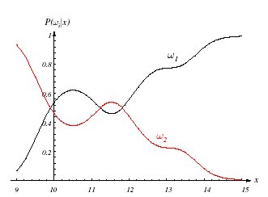
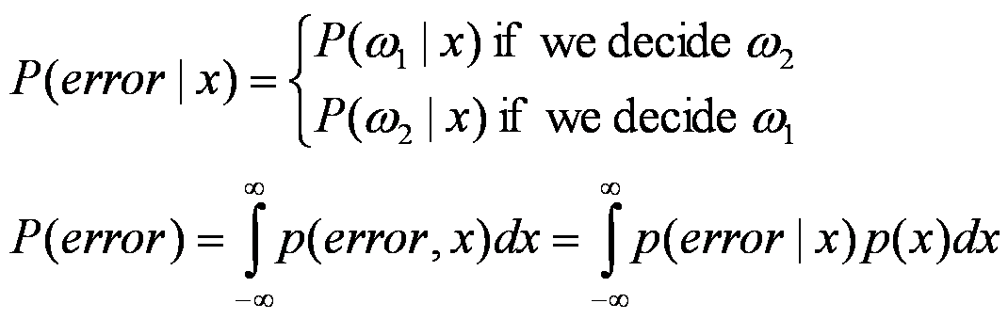
3.1 Bayesian classifier
Two pattern classes:
x is a pattern vector
choose w1 for a specific x if P(w1|x)>P(w2|x)
could be written as P(w1)P(x|w1)>P(w2)P(x|w2)
based on the criterion to achieve the minimum overall error
National Taiwan University, Taipei, Taiwan
DISP Lab @ MD531

Slide 15
Bayesian classifier
Multiple pattern classes:
Risk based: conditional risk
Minimum overall error based:
National Taiwan University, Taipei, Taiwan
DISP Lab @ MD531

Slide 16
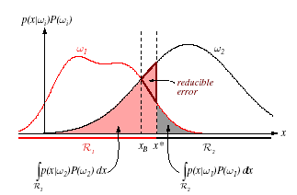
Bayesian classifier
Decision function:
A classifier assigns x to class wi if di(x)>dj(x) for all i ≠ j
where di(x) are called decision (discriminant) functions
Decision Boundary:
The decision boundary between wi and wj for i ≠ j is that di(x)=dj(x)
National Taiwan University, Taipei, Taiwan
DISP Lab @ MD531

Slide 17
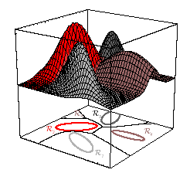
Bayesian classifier
The most important point: probability model
The widely-used model: Gaussian distribution
for x is one-dimensional:
for x is multi-dimensional:
National Taiwan University, Taipei, Taiwan
DISP Lab @ MD531

Slide 18

3.2 Neural network
Without using statistical information
Try to imitate how human learn
A structure is generated based on perceptrons
(hyperplane)
National Taiwan University, Taipei, Taiwan
DISP Lab @ MD531

Slide 19
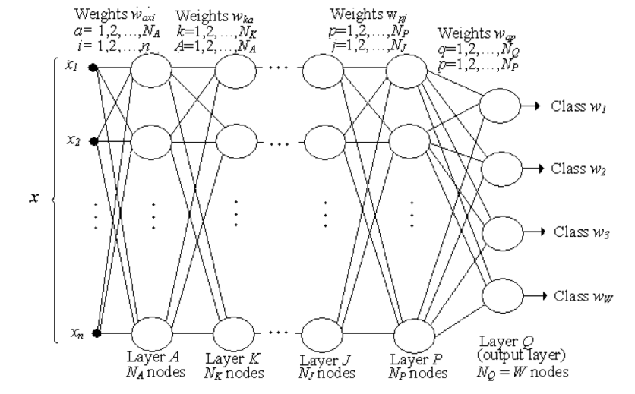
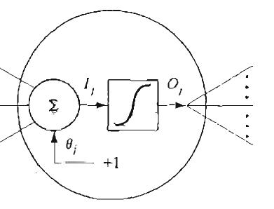
Neural networks
Multi-layer neural network
National Taiwan University, Taipei, Taiwan
DISP Lab @ MD531

Slide 20
Neural network
What we need to define?
Set the criterion for finding the best classifier
Set the desired output
Set the adapting mechanism
The learning step:
1. Initialization: Assigning an arbitrary set of weights
2. Iterative step: Backward propagated modification
3. Stopping mechanism: Convergence under a threshold
National Taiwan University, Taipei, Taiwan
DISP Lab @ MD531

Slide 21
Neural network
Complexity of Decision Surface
Layer 1: line
Layer 2: line intersection
Layer 3: region intersection
National Taiwan University, Taipei, Taiwan
DISP Lab @ MD531

Slide 22

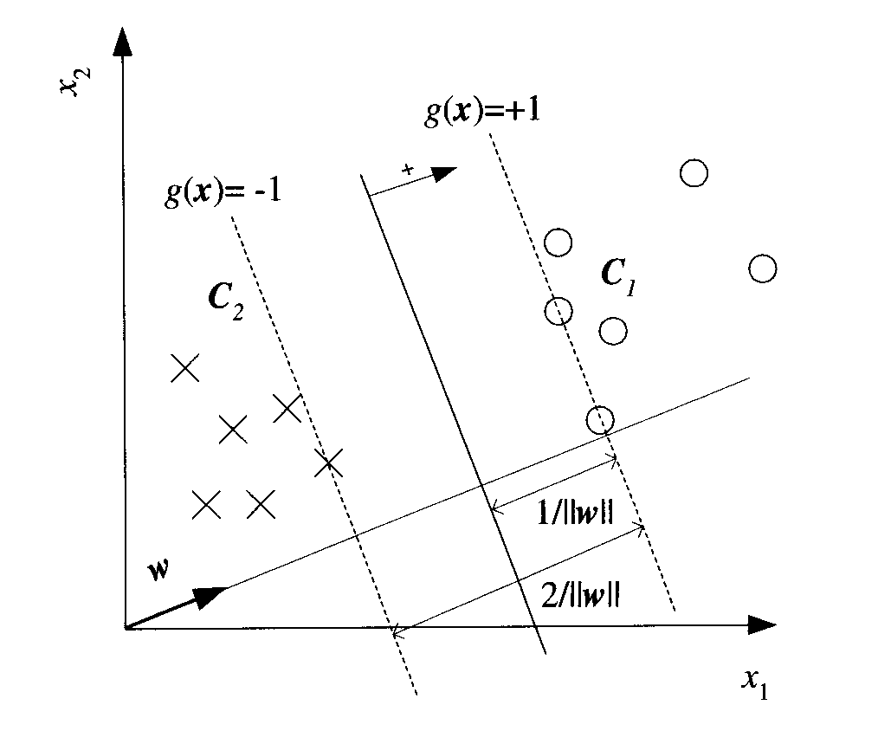
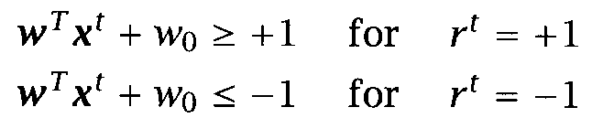
Popular methods nowadays
Boosting:
combining multiple learners
Gaussian mixture model (GMM):
Support vector machine (SVM):
National Taiwan University, Taipei, Taiwan
DISP Lab @ MD531

Slide 23
4. Classification method II
Template matching:
There exists some relation between components of a pattern vector
Methods:
Measures based on correlation
Computational consideration and improvement
Measures based on optimal path searching techniques
  Deformable template matching
National Taiwan University, Taipei, Taiwan
DISP Lab @ MD531

Slide 24




4.1 Measures based on correlation
Distance:
Normalized correlation:
where i, j means the overlap region under translation
Challenge:
rotation, scaling, translation (RST)
National Taiwan University, Taipei, Taiwan
DISP Lab @ MD531

Slide 25

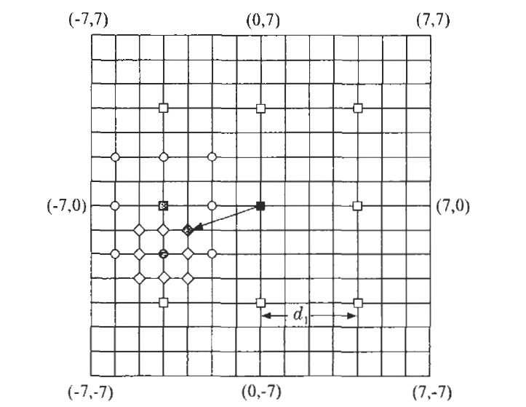
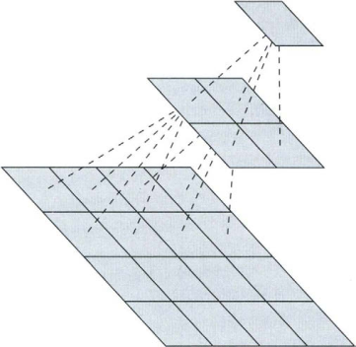
4.2 Computational consideration and improvement
Cross-correlation via its Fourier transform
Direct computation:
via the search window
Improvement:
Two-dimensional logarithmic search
Hierarchical search
Sequential methods
National Taiwan University, Taipei, Taiwan
DISP Lab @ MD531

Slide 26
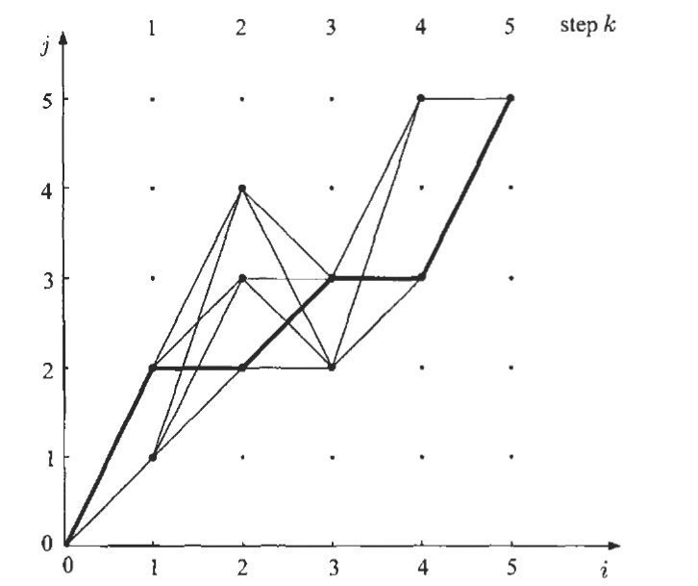


4.3 Measures based on optimal path searching techniques
Pattern vectors are of different lengths
Basic structure:
Two-dimensional grid
Elements of sequences on axes
Each grid means correspondence between
respective elements of the two sequences
A path:
Associated overall cost D:
means the distance between respective elements of two strings
National Taiwan University, Taipei, Taiwan
DISP Lab @ MD531

Slide 27

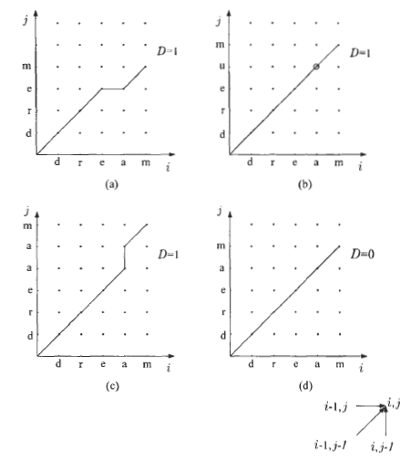
Measures based on optimal path searching techniques
Fast algorithm: Bellman’s principle
the optimal path
Necessary settings:
Local constraint: Allowable transitions
Global constraints: Dynamic programming
End point constraints
Cost measure: or
National Taiwan University, Taipei, Taiwan
DISP Lab @ MD531

Slide 28
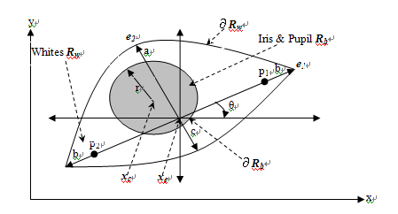

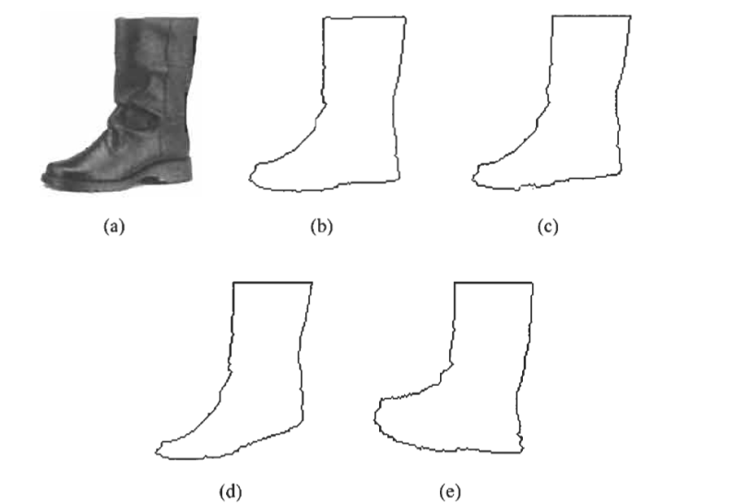
4.4 Deformable template matching
Deformation parameters:
Prototype
A mechanism to deform the prototype
A criterion to define the best match:
-deformation parameter
-matching energy
-deformation energy
National Taiwan University, Taipei, Taiwan
DISP Lab @ MD531

Slide 29
5. Classification method III
Context-dependent methods:
the class to which a feature vector is assigned depends
(a) on its own value
(b) on the values of the other feature vectors
(c) on the existing relation among the various classes
we have to consider more about the mutual information, which resides within the feature vectors
Extension of the Bayesian classifier:
N observations X: , M classes:
and possible sequence
National Taiwan University, Taipei, Taiwan
DISP Lab @ MD531

Slide 30


Markov chain model
First-order and two assumptions are made to simplify the task:
We can get the probability terms:
National Taiwan University, Taipei, Taiwan
DISP Lab @ MD531

Slide 31




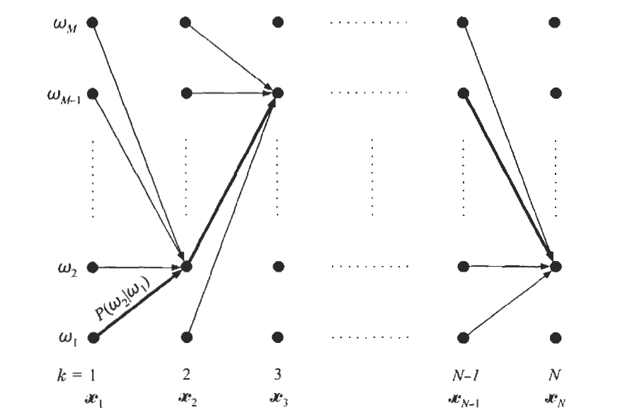


The Viterbi Algorithm
Computational complexity: Direct way:
Fast algorithm: Optimal path
Cost function of a transition:
The overall cost:
Take the logarithm:
Bellman’s principle:
National Taiwan University, Taipei, Taiwan
DISP Lab @ MD531

Slide 32



Hidden Markov models
Indirect observations of training data:
Since the labeling has to obey the model structure
Two cases:
One model for (1) each class or (2) just an event
Recognition: Assume we already know all PDF and types of states
All path method:
Each HMM could be described as:
Best path method: Viterbi algorithm
National Taiwan University, Taipei, Taiwan
DISP Lab @ MD531

Slide 33
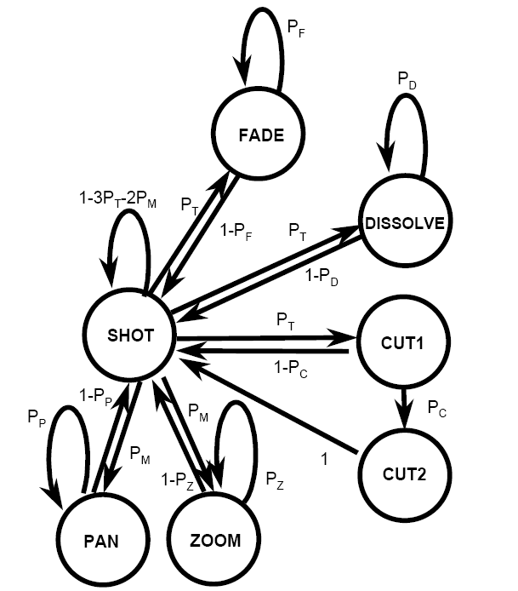
Training of HMM
The most beautiful part of HMM
For all path method:
Baum-Welch re-estimation
For best path method:
Viterbi re-estimation
Probability term:
Discrete observation: Look-up table
Continuous observation: Mixture model
National Taiwan University, Taipei, Taiwan
DISP Lab @ MD531

Slide 34
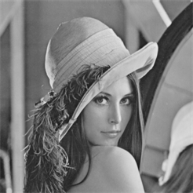
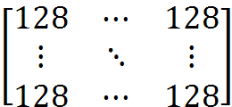
6. Feature Generation
Inability to use the raw data:
(1) the raw data is too big to deal with
(2) the raw data can’t give the classifier the same sense what people feel about the image
National Taiwan University, Taipei, Taiwan
DISP Lab @ MD531

Slide 35

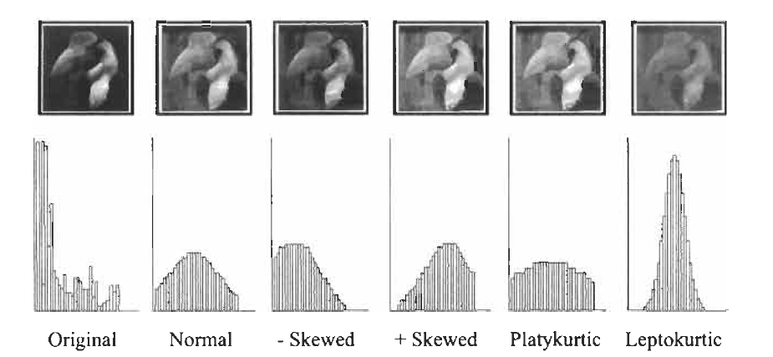


6.1 Regional feature
First-order statistical features:
mean, variance, skewness, kurtosis
Second-order statistical features—Co-occurrence matrices
National Taiwan University, Taipei, Taiwan
DISP Lab @ MD531

Slide 36
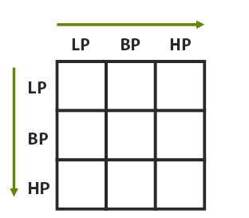
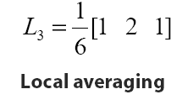
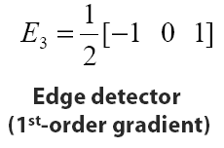
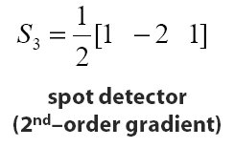
Regional feature
Local linear transforms for texture extraction
Geometric moments: Zernike moments
Parametric models: AR model
National Taiwan University, Taipei, Taiwan
DISP Lab @ MD531

Slide 37

6.2 Shape & Size
Boundary:
Segmentation algorithm -> binarization -> and boundary extraction
Invertible transform:
Fourier transform
Fourier-Mellin transform
National Taiwan University, Taipei, Taiwan
DISP Lab @ MD531

Slide 38
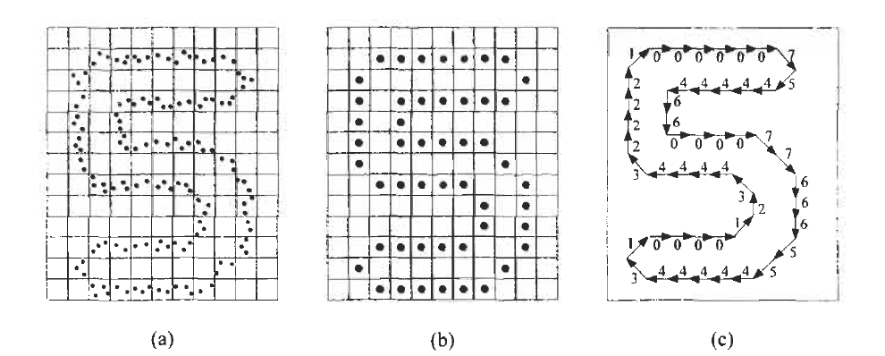
6.2 Shape & Size
Chain Codes:
Moment-based features: Geometric moments
National Taiwan University, Taipei, Taiwan
DISP Lab @ MD531

Slide 39
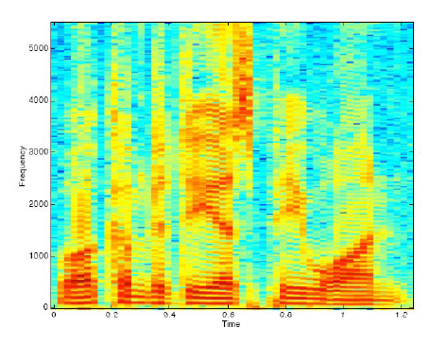
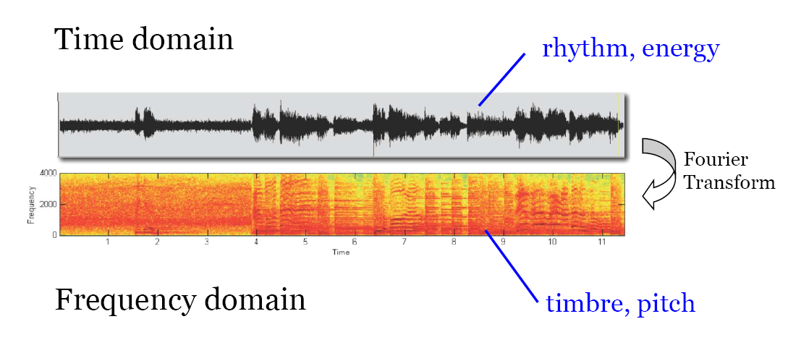
6.3 Audio feature
Timbre: MFCC
Rhythm: beat
Melody: pitch
National Taiwan University, Taipei, Taiwan
DISP Lab @ MD531

Slide 40
7. Feature Selection
The main problem is the curse of dimensionality
Reasons to reduce the number of features:
Computational complexity:
Trade-off between effectiveness & complexity
Generalization properties:
Related to the ratio of # training patterns to # classifier parameters
Performance evaluation stage
Basic criterion:
Maintain large between-class distance and small within-class variance
National Taiwan University, Taipei, Taiwan
DISP Lab @ MD531

Slide 41
8. Outstanding Application
Speech recognition
Movement recognition
Personal ID
Image retrieval by object query
Camera & video recorder
Remote sensing
Monitoring
……
National Taiwan University, Taipei, Taiwan
DISP Lab @ MD531

Slide 42
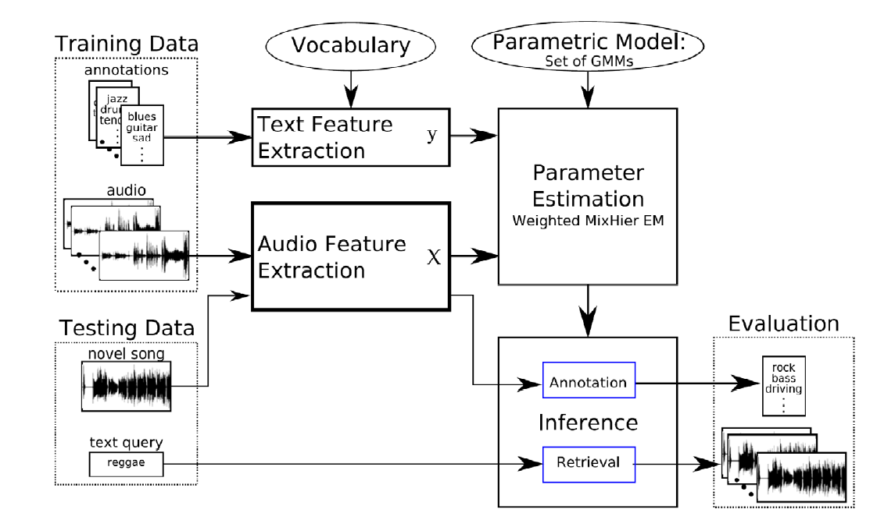
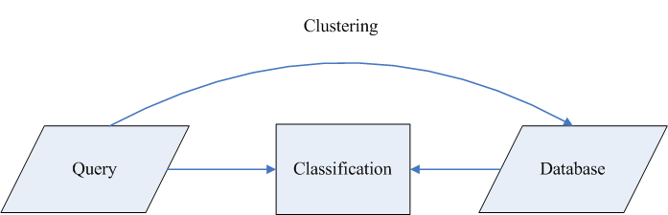
Outstanding Application
Retrieval:
National Taiwan University, Taipei, Taiwan
DISP Lab @ MD531

Slide 43
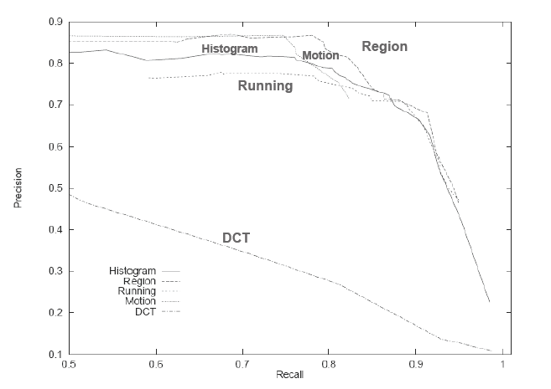
Evaluation method
P-R curve:
Precision: a/c
Recall: a/b
a: # true got
b: # retrieval
c: # ground truth

Slide 44
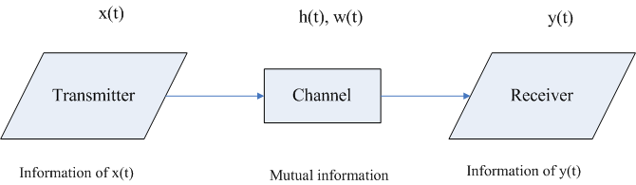

9. Relation between IT and D&E
Transmission:
Pattern recognition:
National Taiwan University, Taipei, Taiwan
DISP Lab @ MD531

Slide 45
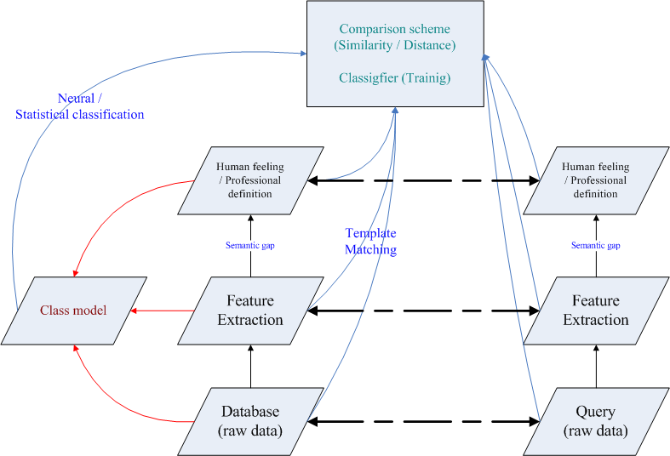
Graph of my idea
National Taiwan University, Taipei, Taiwan
DISP Lab @ MD531

Slide 46
10. Conclusion
Pattern recognition is nearly everywhere in our life, each case relevant to decision, detection, retrieval can be a research topic of pattern recognition.
The mathematics of pattern recognition is widely-inclusive, the methods of game theory, random process, decision and detection, or even machine learning.
Feature cases:
New features
Better classifier
Theory
National Taiwan University, Taipei, Taiwan
DISP Lab @ MD531

Slide 47
Idea of feature
Different features perform well on different application:
Ex: Video segmentation, video copy detection, video retrieval all use features from images (frame), while the features they use are different.
Create new features
National Taiwan University, Taipei, Taiwan
DISP Lab @ MD531

Slide 48
Idea of training
Basic setting:
Decision criterion
Adaptation mechanism
Initial condition
Challenge:
Insufficient training data
Over-fitting
National Taiwan University, Taipei, Taiwan
DISP Lab @ MD531

Slide 49
Reference
[1] R. C. Gonzalez, “Object Recognition,” in Digital image processing, 3rd ed. Pearson, August 2008, pp. 861-909.
[2] Shyh-Kang Jeng, “Pattern recognition - Course Website,” 2009. [online] Available: http://cc.ee.ntu.edu.tw/~skjeng/PatternRecognition2007.htm. [Accessed Sep. 30, 2009].
[3] D. A. Forsyth, “CS 543 Computer Vision," Jan. 2009. [Online]. Available: http://luthuli.cs.uiuc.edu/~daf/courses/CS5432009/index.html. [Accessed: Oct. 21, 2009].
[4] Ke-Jie Liao, “Image-based Pattern Recognition Principles,” August 2008. [online] Available: http://disp.ee.ntu.edu.tw/research.php. [Accessed Sep. 19, 2009].
[5] E. Alpaydin, Introduction to Machine Learning. The MIT Press, 2004.
[6] S. Theodoridis, K. Koutroumbas, Pattern Recognition, 2nd ed. Academic Press, 2003.
[7] A. Yuille, P. Hallinan, and D. Cohen, “Feature Extraction from Faces Using Deformable Templates,” Int’l J. Computer Vision, vol. 8, no. 2, pp. 99-111, 1992.
[8] J.S. Boreczky, L.D. Wilcox, “A hidden Markov model framework for video segmentation using audio and image features," in Proc. Int. Conf. Acoustics, Speech, and Signal Processing (ICASSP-98), Vol. 6, Seattle, WA, May 1998.
[9] Ming-Sui Lee, “Digital Image Processing - Course Website,” 2009. [online] Available: http://www.csie.ntu.edu.tw/~dip/.
[Accessed Oct. 21, 2009].
[10] W. Hsu, “Multimedia Analysis and Indexing – Course Website,” 2009. [online] Available: http://www.csie.ntu.edu.tw/~winston/courses/mm.ana.idx/index.html. [Accessed Oct. 21, 2009].
[11] R. O. Duda, P. E. Hart, and D. G. Stork, Pattern Classification, ed. John Wiley & Sons, 2001.

